Slide 1

Kofax Today
David.Wright@Kofax.com
Partner Development Manager

Slide 2
Agenda
Introduction
Hyperautomation
Where is Kofax Today?
Roadmap themes
Customer Experience, Continuous Engagement
Customer Engagement

Slide 3
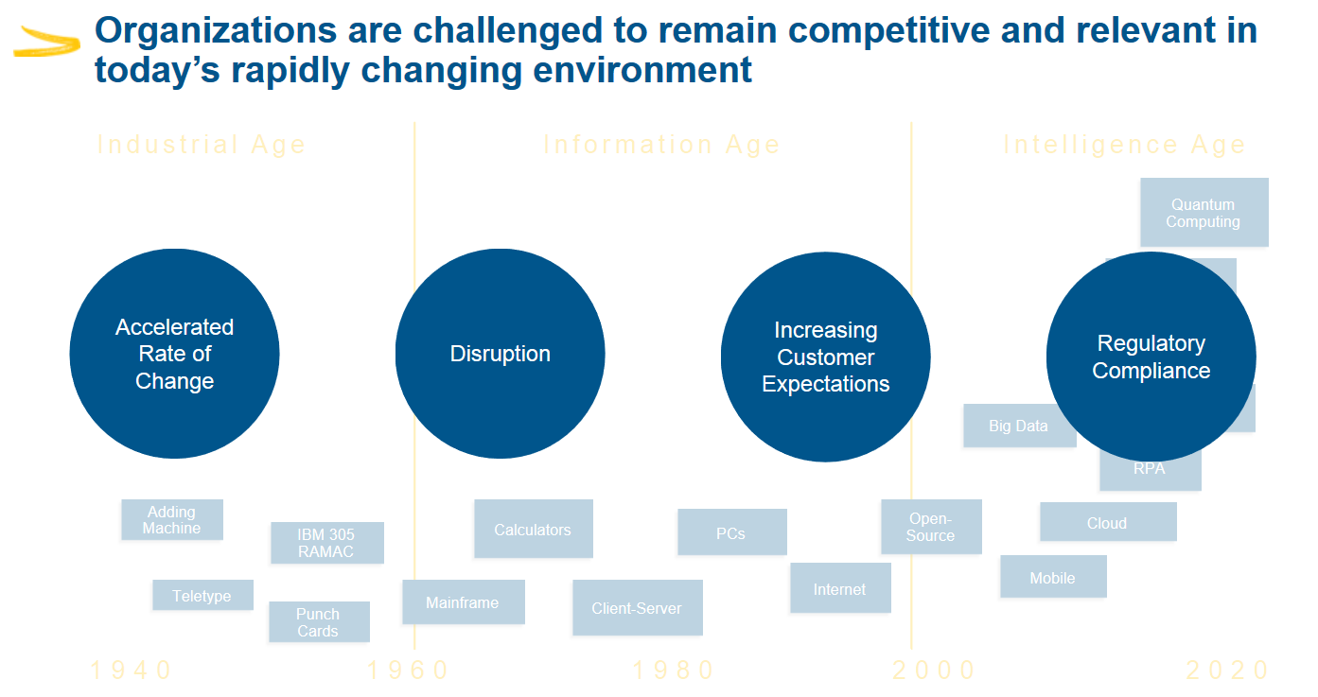



Notes:
We have been living through a century of massive change in industry, information, and now perhaps the intelligence age. Cloud, pandemic, climate, war are now all front of mind.
We are in a phase of consolidation and optimization of new technologies.

Slide 4
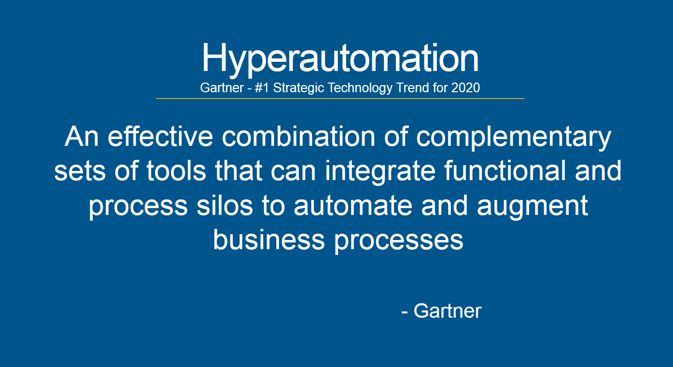
Notes:
Hyperautomation is bringing together all the tools we’ve had now for nearly 40 years. And it is our job to make this personal and benefit the people working for our customers.

Slide 5
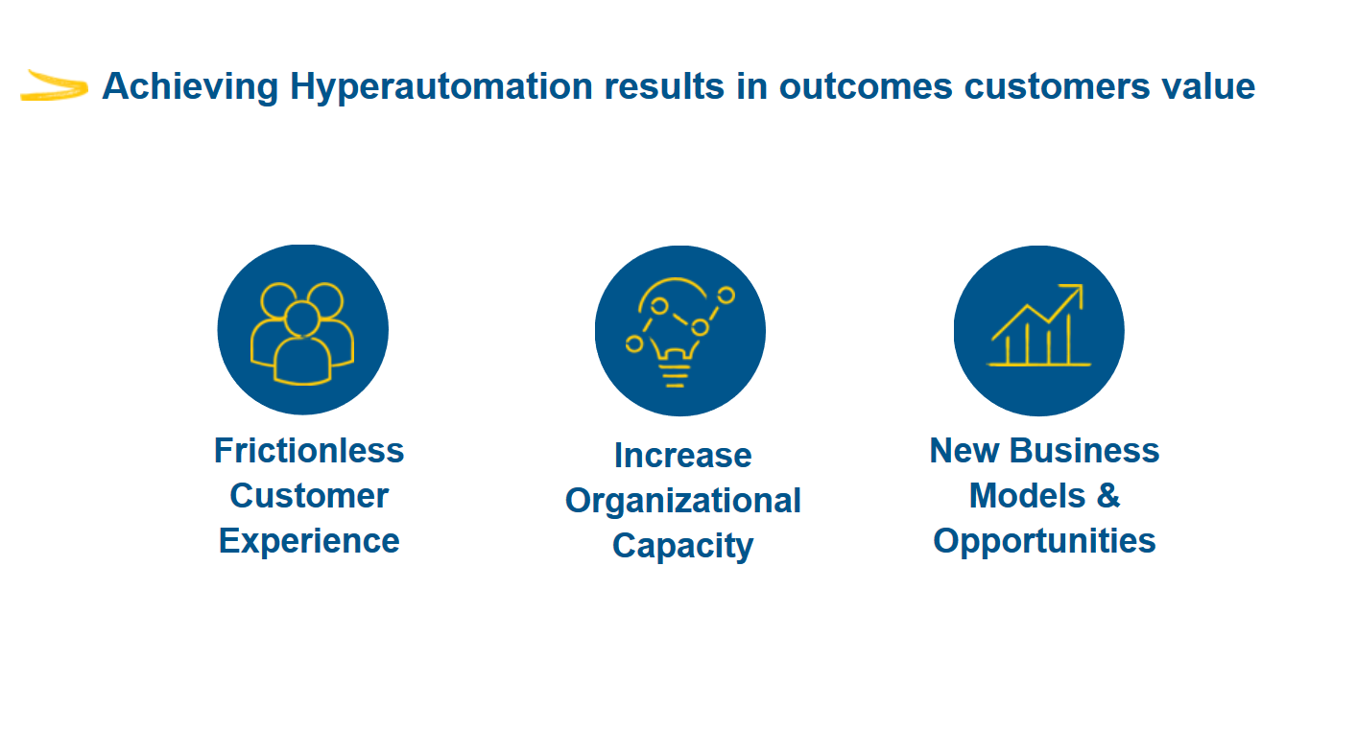
Notes:
People can get what they need, fast, seamlessly and transparently.
Works are happier, focused, relaxed and can be more creative.
This unleashes new possibilities.

Slide 6
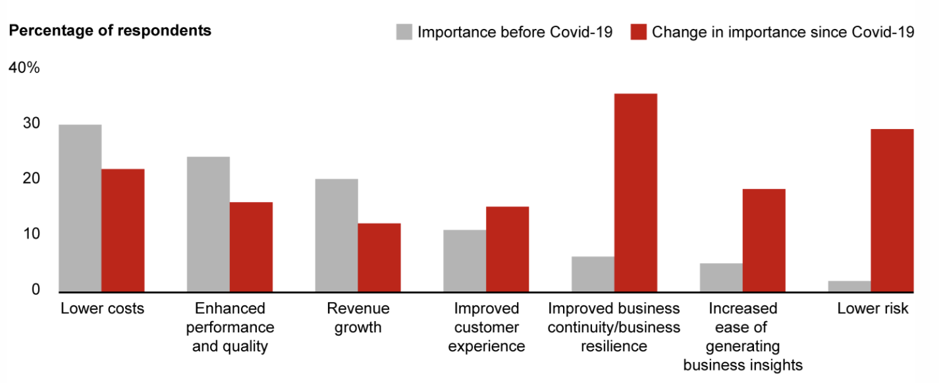
Companies’ automation priorities extend beyond cost savings and revenue growth
Which Automation goal was the most important prior to Covid-19 for your organization? How has that changed?
Source: Bain & Company: Reinventing Business through Automation; March 2021
https://www.bain.com/insights/beyond-cost-savings-reinventing-business-through-automation/

Slide 7
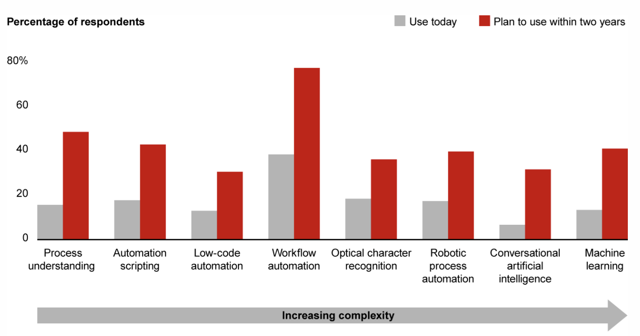
Companies plan to adopt a broader range of technologies to achieve more value from automation
Source: Bain & Company: Reinventing Business through Automation; March 2021
https://www.bain.com/insights/beyond-cost-savings-reinventing-business-through-automation/

Slide 8
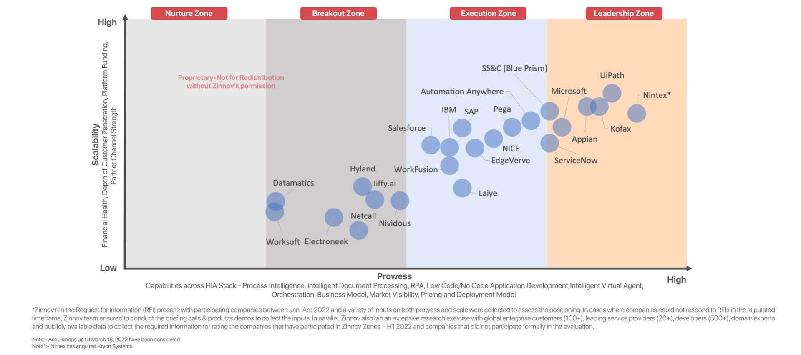
Zinnov Zones – Hyper Intelligent Automation 2020
Notes:
Here we see the results of the last 4 years of strategy of Kofax’ focus on Hyper Intelligent Automation.
Kofax has moved

Slide 9
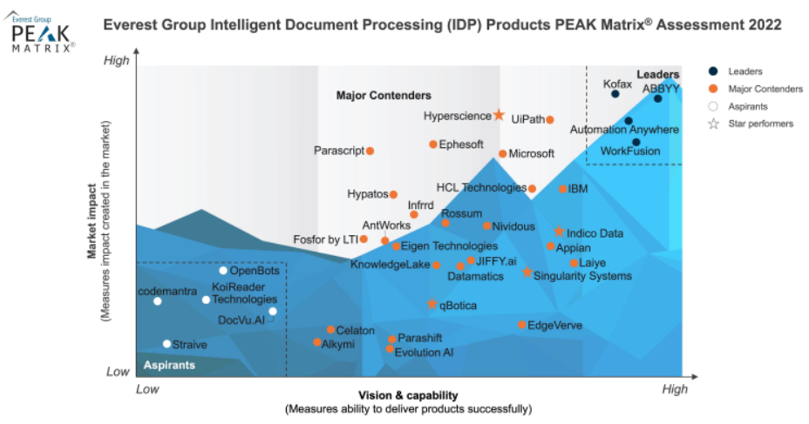
Leadership ranking in Intelligent Document Processing

Slide 10
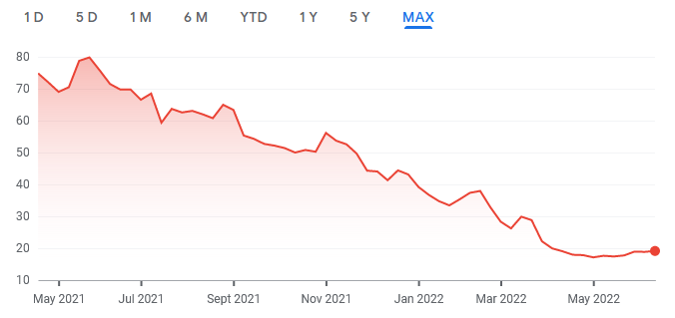
Where is Kofax today?
Software companies are seeing a reset in pricing
With inflation, Covid, Ukraine.
Kofax is growing while the market is being fearful.
Kofax was acquired by TA Associates and Clearlake in 2022, two reputable investor groups that sees Kofax as an opportunity in a turbulent market.
Kofax’ software is mission critical to our customers.
Kofax is pursuing a Cloud First Strategy
Cloud means focus on customer journey, not “top of funnel” selling.
FEAR
Investors are paying less for future earnings
Kofax processed 4 billion pages in the Cloud in 2021
Notes:
Many of Kofax’ customers are seeking solutions to the inflationary and supply chain issues that are preventing them from selling their goods and services at the margins they need.
Economic slowdown is always an opportunity for Kofax as we share the value of our automation solutions that remove cost and friction.
Cloud First means we can sell what the market needs today, not commoditized software of yesterday. Kofax has remarkable revenue growth in selling Cloud solutions in 2022. It is appealing and easier buy for customers.

Slide 11




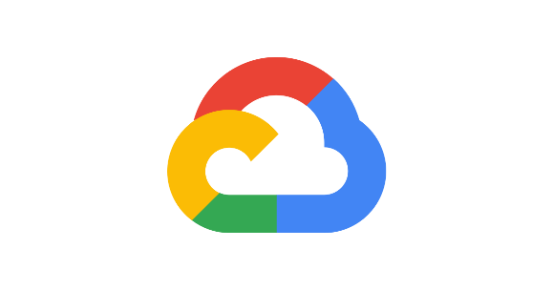

Our ‘Cloud Choice’ strategy supports enterprise customers that typically leverage a hybrid cloud environment
Kofax Cloud
Customer Cloud
On-Premises
Kofax SaaS on Microsoft Azure
Dedicated instance or Public Tenant
Term License
Support Included
Deploy in your preferred cloud
Customer Managed Data Center
Single Instance or Multi-Tenant (OPMT)
Perpetual or Term License
Separate Support Contract
containerization

Slide 12
Technology Innovation Roadmap at Kofax
Notes:
What is your vision and roadmap for your product and related offerings? How has it evolved over the last 12 months? What changed due to COVID-19?
Cloud – so the next area we are seeing this past year, is around capture in the cloud, more organizations are trusting the cloud, consumption has exploded due to covid, we have many cloud offerings across our product portfolio, but one I wanted to highlight is TotalAgility Cloud, and this is the ability to capture documents, perform analytics, and orchestrate business processes as part of our intelligent automation platform, we have a strategy to expand with RPA in the cloud as well as mobility and engagement in the cloud, so things like e-signature and digital identity verification, so moving that to the cloud as well. We run in Azure with a multi-tentant or dedicated options, we also have the ability to provide KTA to customers and have them deploy it in their own cloud, whichever they choose, whether that is Azure or AWS, we feel that is a key differentiator is the power of choice.
A need to interface with your on prem systems, on prem device, scanner or email server, or on ERP system that need to send documents to and from, so whether you are capturing from front end or back end, KTA provides an integration server which is a way to have one entry and exit point that sits on the customer premise point to allow them to do the communication between on prem and cloud, we are seeing more trust in the underlying architecture, there are certifications required in certain markets and certain verticals and we are sensitive to that. The reason people want to go dedicated is to control upgrade timing, pay a bit more and control when you upgrade to KTA. Entry level KTA is 10K on prem, a little higher than that for cloud, that’s just to get in, it goes up from there based on pages and users. $10k perpetual price. For term 3 or 5k per year, if it’s cloud you are closer to $20k range. You can get started pretty low amount of operating in the Cloud, and get started right away with 100k pages of capture. No disconnection charge.
We have other cloud offerings as well

Slide 13
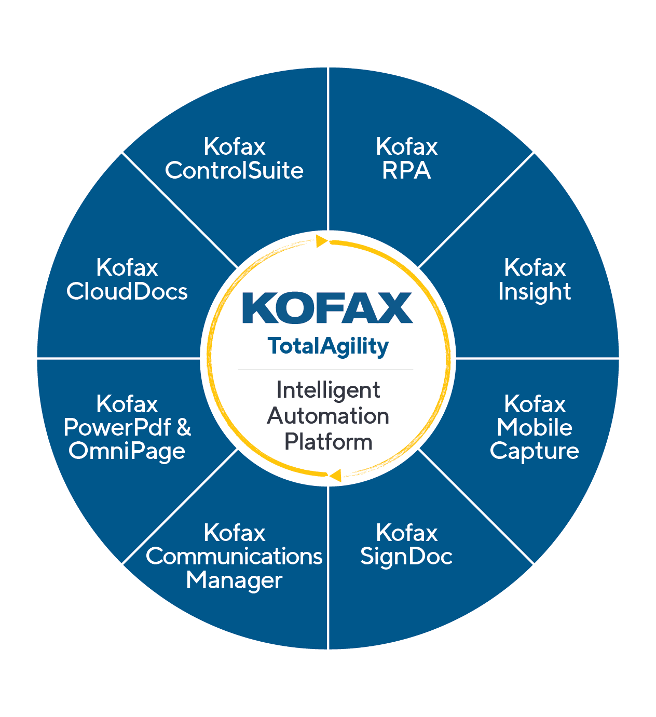
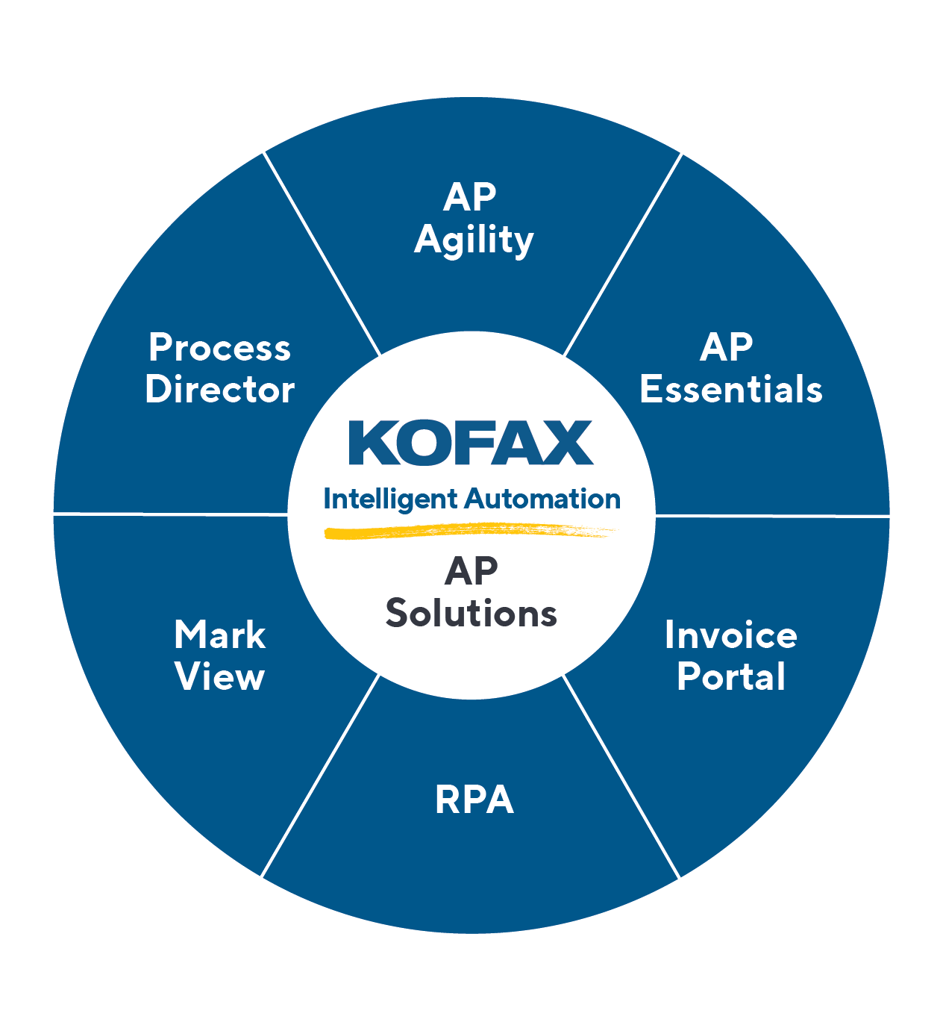


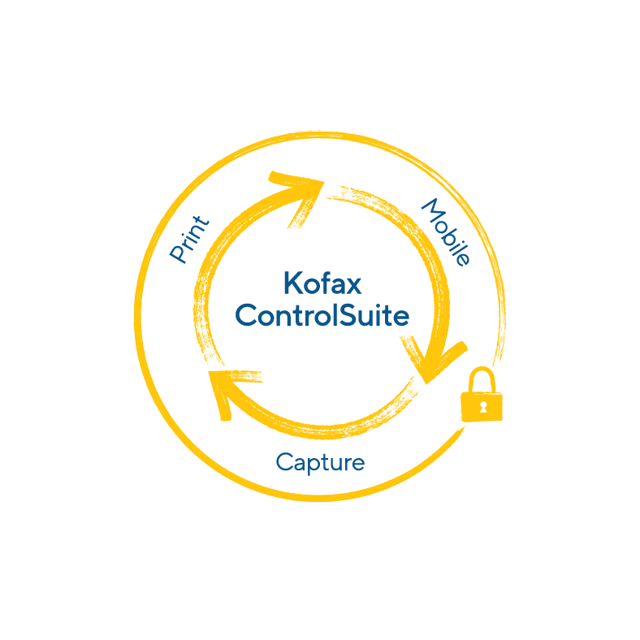


Our Automation Portfolio digitally transforms Content-Intensive Workflows… and differentiates us from the Competition
Kofax Automation
Intelligent Automation
Print Automation
Intelligent Automation Platform
Accounts Payable Solutions
Print Infrastructure & Management Platforms
Productivity Solutions
a global B2B e-invoicing network
Notes:
Throughout ‘22 we will continue to strengthen the integration of our comprehensive Automation portfolio that provides you the ability to penetrate different LOB customers with up and cross-sell potential
We will continue to win in the enterprise and SMB markets by focusing on what differentiates us from the competition
And what differentiates Kofax is our ability to use our Cognitive Capture heritage, coupled with our Workflow Orchestration strategy…to transform content-intensive workflows
This stands true across IA, AP, PA and Productivity
Focusing on Digitally Transforming ‘Content-Intensive’ Workflows is the way we expand from back-office document imaging use cases to front office complex content-intensive use cases WHILE differentiating ourselves from other Workflow solutions

Slide 14
Understand the Customer

Slide 15
Customer Engagement
Customer Analysis
Corporate Vision of CEO, Board
Goals of CxO
Needs of Department
Pains of workers
Notes:
Write down the corporate vision and mission statement. What are the CEO’s plans for the next year? Read the website. If the company is publically listed in the USA, read the business risks in their SEC quarterly reports.
Expect your sales colleagues to have done this deep analyse and be able to itemize and prioritize the goals, needs and pains.

Slide 16
Customer Qualification
(Executive) Vision – why the company exists, purpose, mission
Simplify, best in field, best services, innovate, sustainability, social responsibility
What is the corporate vision on the website?
(Operational) Goals - what they want to do
Improving speed, quality, service, growth, efficiency, market position, trust, creative,
“Automate”, transparency, customer satisfaction, prioritize
Save money, create value
(Departmental) Needs - what they need to do to achieve a goal
Comply, digitize, migrate, simplify, integrate, secure, retrieve, uptime, track, coordinate, streamline, “touchless”, measure …, keep employees happy and content, failure is not an option. Accuracy (quality of data), tracking, time frames, creative, error handling, productivity
(Departmental) Pains - prevents them from reaching a goal.
What happens if we do nothing at all?
Slow, intransparent, lost, wrong, complaints, increasing costs, complex, wasteful, no resources, insecure data, time consuming, tedious
Bold = RPA
Notes:
Who’s job is this?? The Account Manager! Not the Sales Engineer!

Slide 17

A hi-tech company
Corporate Vision
Making Humanity Multiplanetary.
Operational Goals
Make rockets reusable.
Departmental Needs
Build 40 boosters/year.
Departmental Pains
Director removed. Departments merged.
Quality Control on supplied components is a lot of paperwork. Software not keeping up.
IT
Solution too complicated to build. Need outside help.

Slide 18
Not-for-Profit Health Insurance Provider
Executive Vision
Provide premium member services
Living Well
Operation Goals
Get Fit
Retain members
Reduce costs of managing members
Reduce insurance leakage costs
Departmental Needs
Find member insurance information simply and quickly
Launch new products and services faster
Departmental Pains
Historical policies and acquisitions mean information is difficult to obtain
Legacy back end systems require high level of knowledge to use
6-9 months to launch new product

Slide 19
Petroleum Industry
Vision
Leader in transport fuels
Providing reliable, safe quality fuels to diverse market
Also providing retails services
Goals
operational excellence through safe, secure, reliable, efficient, incident-free and environmentally sound operations
capital stewardship by investing in the best project opportunities and executing them better than our strongest competitors
cost management by lowering unit-costs through innovation, technology and work-process improvements
Needs
Undertaking Operating Model Transformation to remain competitive in market place
Making changes to Enterprise Architecture to support future operating environment
Pains
Many legacy systems, many manual tasks that are time consuming
looking for operational efficiencies, to automate and reduce error rates

Slide 20
DMV – Customer Qualification
Vision Statement: DMV is a model state agency delivering exceptional customer service and promoting effective and efficient business processes, professional employees, innovative technology and strategic partnerships.
Goals:
Administer the State's motor vehicle licensing and titling laws by:
maintaining strict controls to deliver secure and valid identification, licenses, property records;
accurately account for the receipt and timely distribution of all revenue collected;
provide the best customer service for serve our citizens.
Values:
Competent, Committed, Courteous

Slide 21



Meet the buyers
Business
VP Operations (line of business), Chief Operating Officer, Chief Data Officer, VP Data Research, Global Process Owner, Director of Process Management, Director/VP of Shared Services, Director of Operational Excellence
Technical
VP/Director of IT, VP/Director of RPA Services
Influencer
CIO, Compliance Officer, Data Research Analyst, Operations Manager

